Slide 1
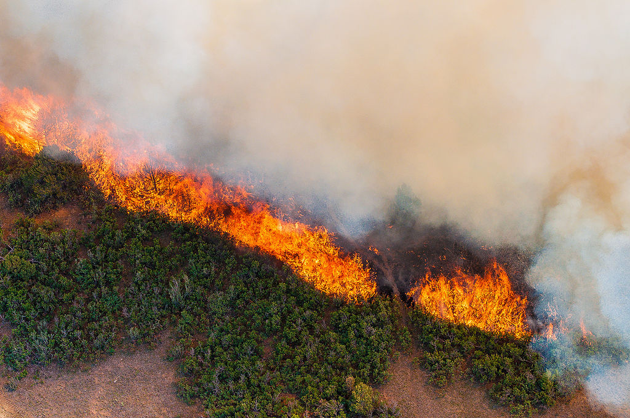

fireWatch
Advance Fire Detection System
This Photo by Unknown Author is licensed under CC BY-SA

Slide 2
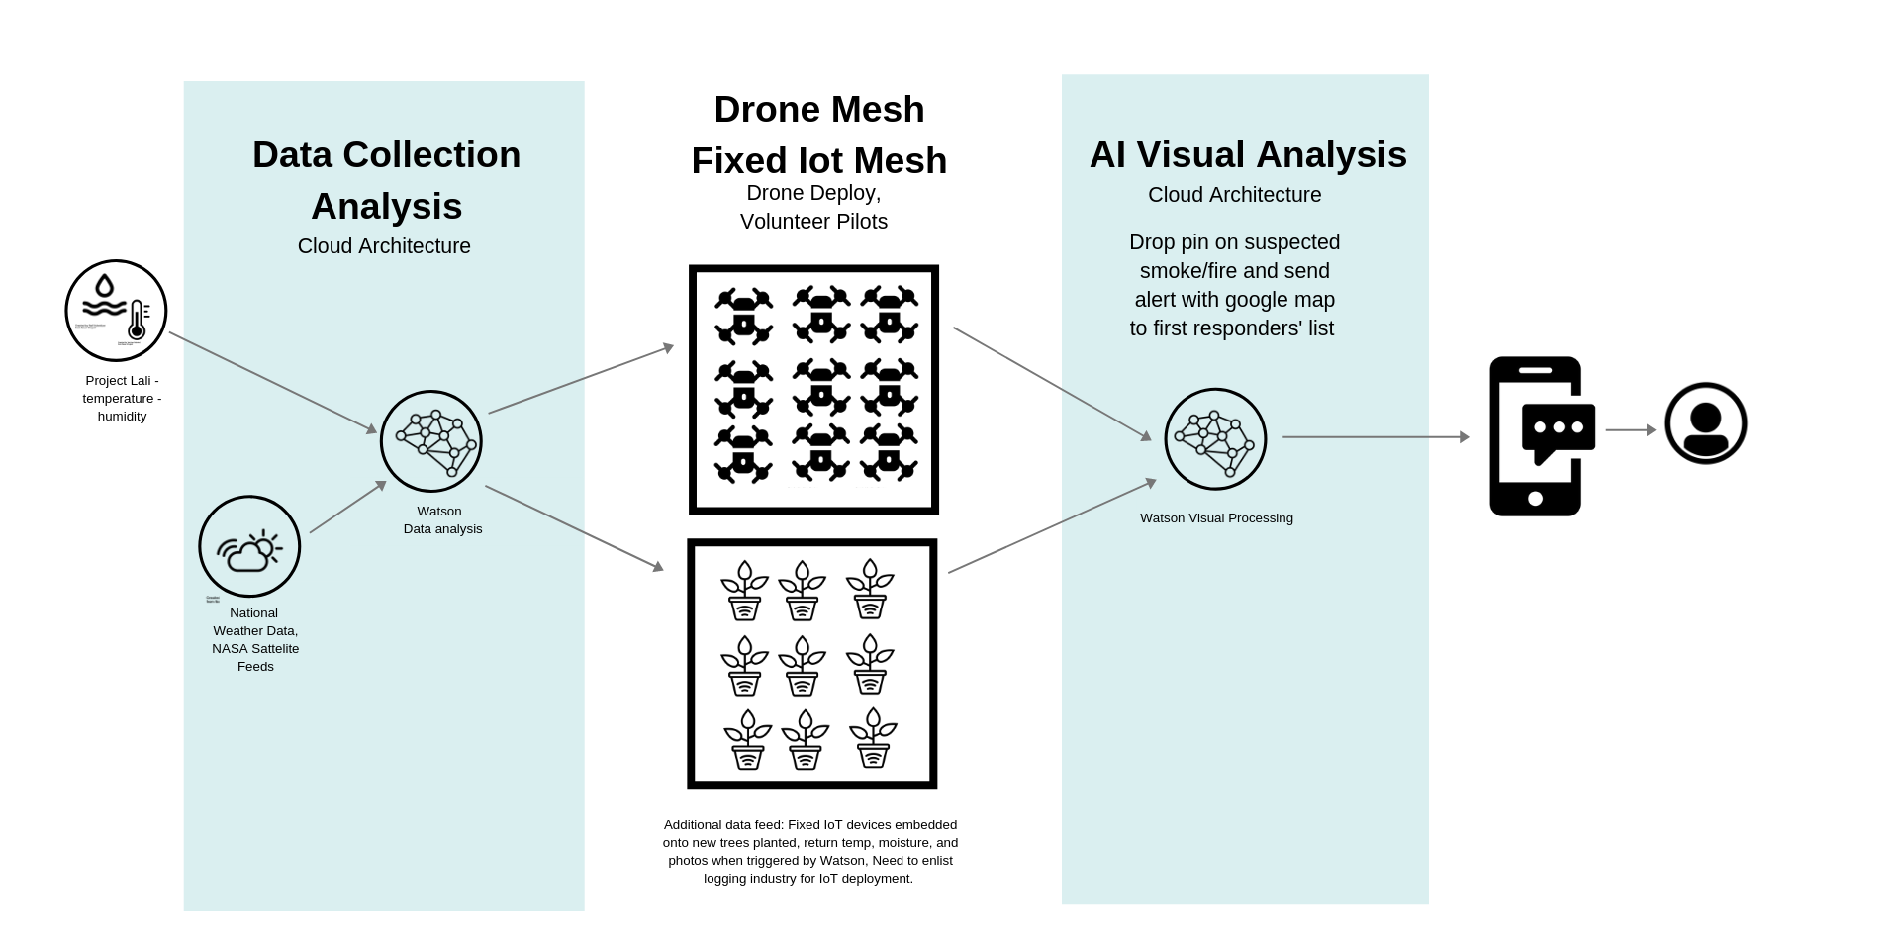
Conceptual Layer

Slide 3
Data Flow Diagram

Slide 4
Data Flow Diagram

Slide 5
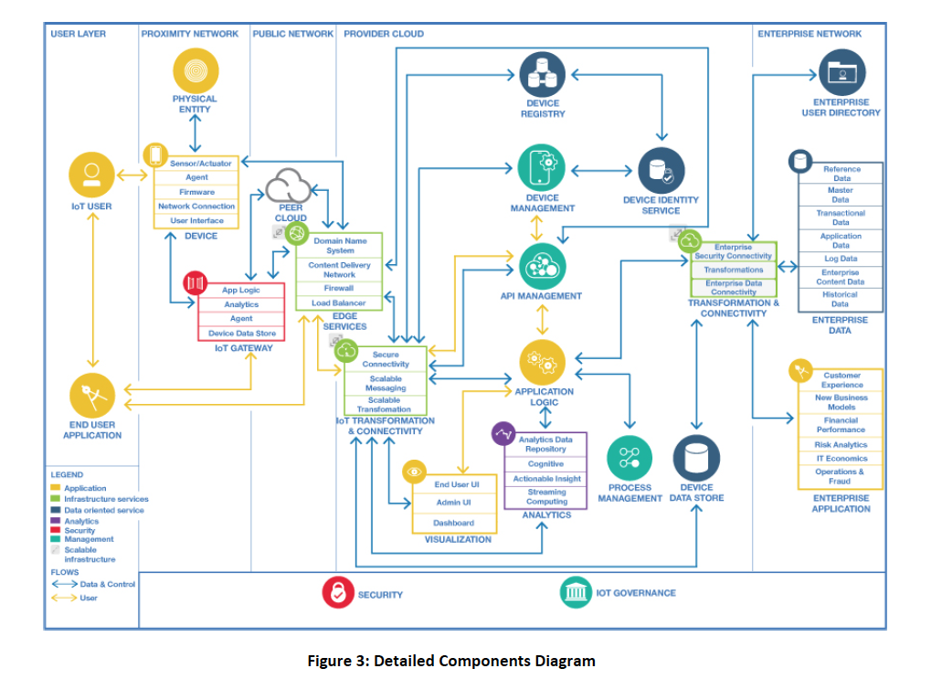
IoT Reference Architecture

Slide 6
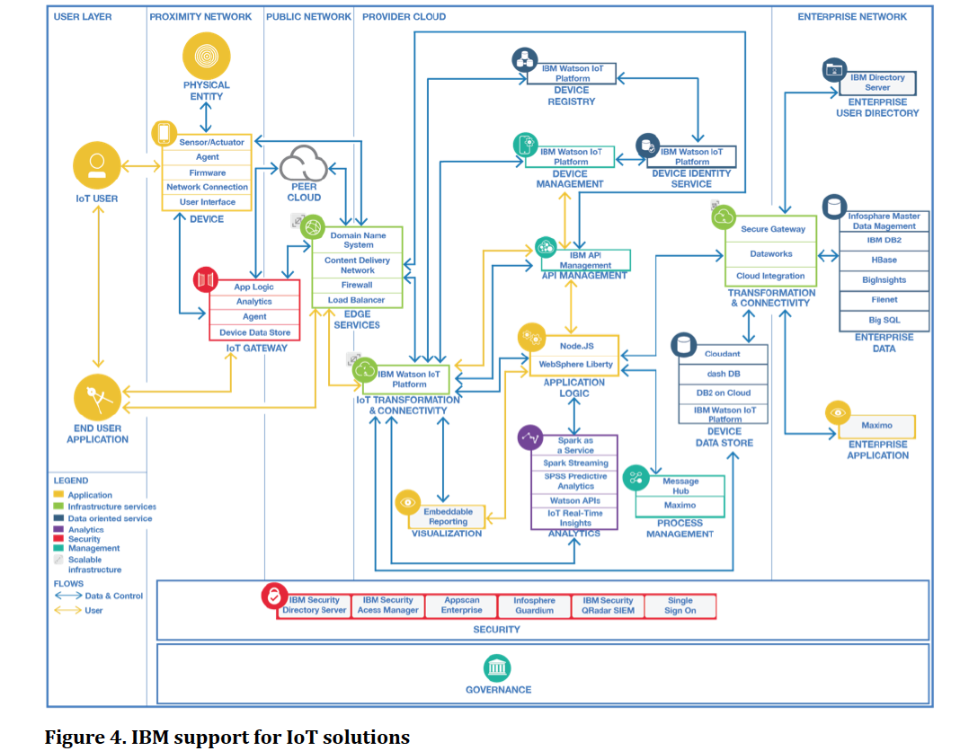
IBM Support for IOT Solutions based on Reference Architecture

Slide 7


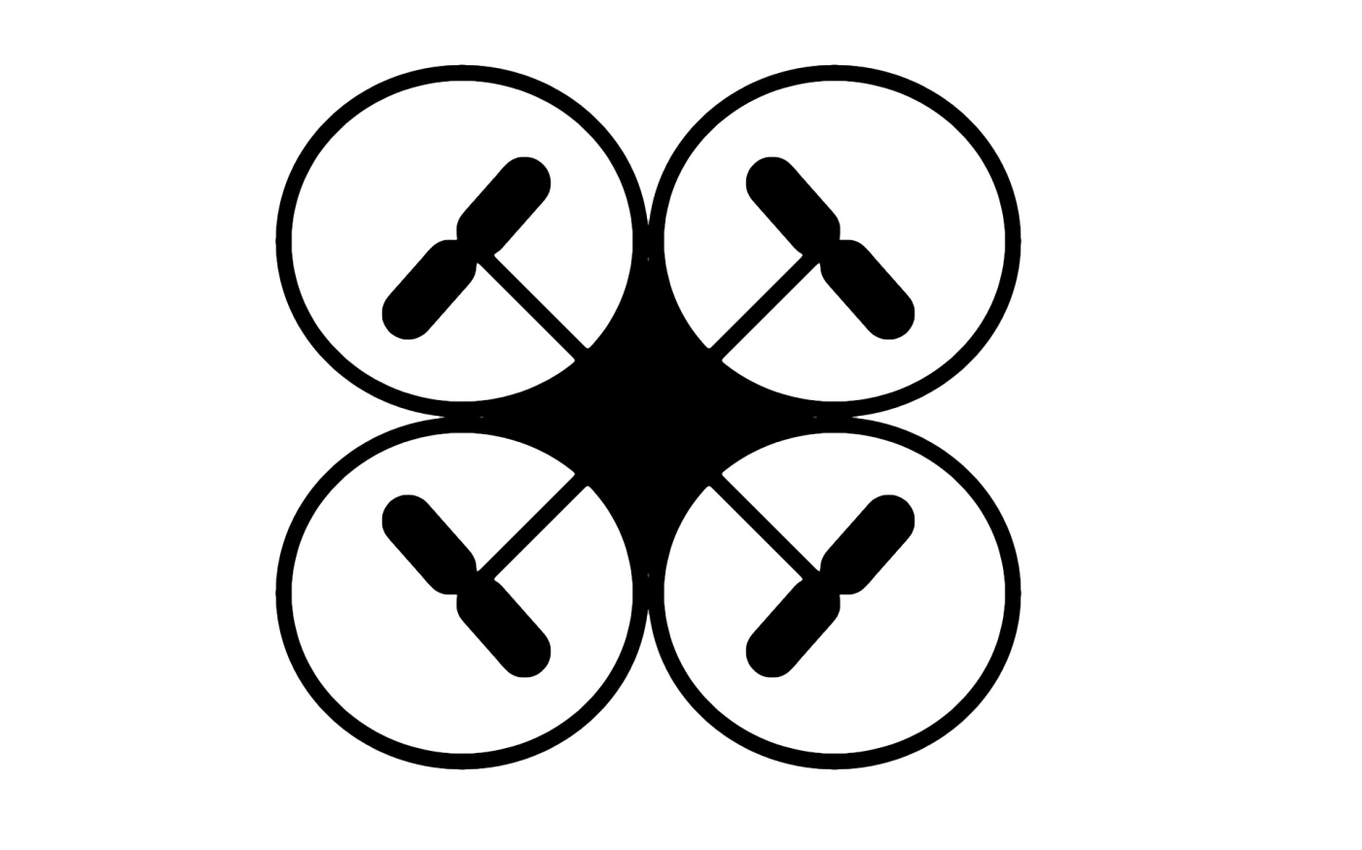




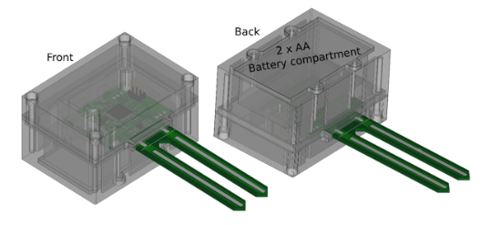

















Opted IoT Solution Architecture for fireWatch Project
App Tier
User Tier
Edge Tier
PROXIMITY NETWORK
PUBLIC NETWORK
Platform Tier
PROVIDER CLOUD (IBM Cloud)
Events Listener
Watson
IoT
Platform
Forests/Land
Drones Mesh
Management
DEVICE
REGISTRY
DEVICE
IOT
USER
Project Lali – Sensors
DEVICE
MANAGEMENT
DEVICE IDENTITY
SERVICE
Temperature, Moisture
Optional Orchestrator
Monitoring
Watson
IoT
Platform
MICROSERVICES
MESH
Push Notification
API MANAGEMENT
React Native
IoT
GATEWAY
EDGE SERVICES
Front-end Application
First Responder
IoT TRANSFORMATION
&CONNECTIVITY
ACTIONABLE
INSIGHT
APPLICATION
LOGIC
NoSQL
Cloudant DB
LEGEND
Cloud DB2
Application
Watson Visual Recognition
ANALYTICS
DATA STORE
Infrastructure
Data Store
Management
Scalable
Security
SECURITY
KEY MANAGEMENT
SERVICE
INDENTITY &
ACCESS MANAGEMENT
Analytics

